Slide 1

FAQ Page
Sachit Sharma
(2021A1R027)
Under the guidance of:
Paramveer Nandaal
Co-Founder & CEO Nucleon
IIT JAMMU

Slide 2
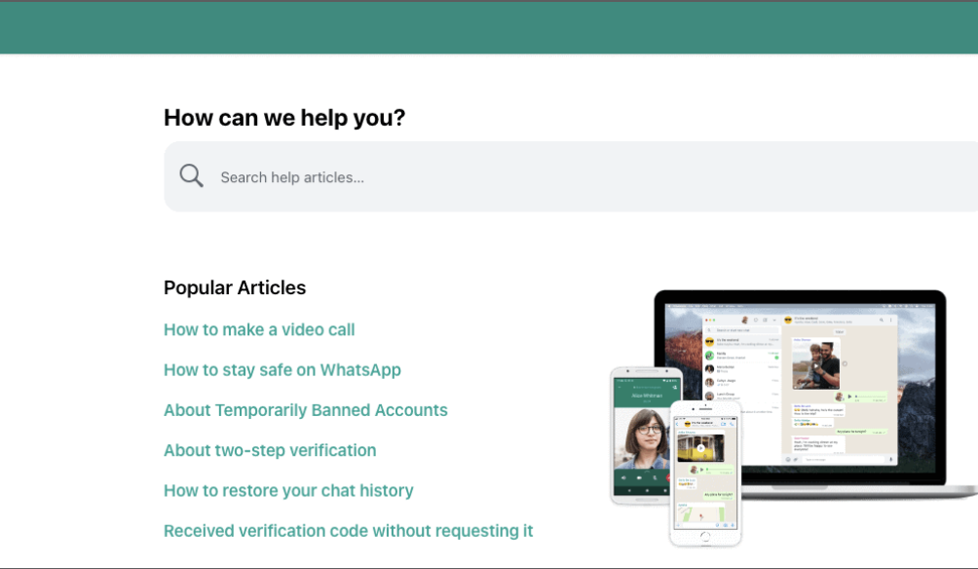
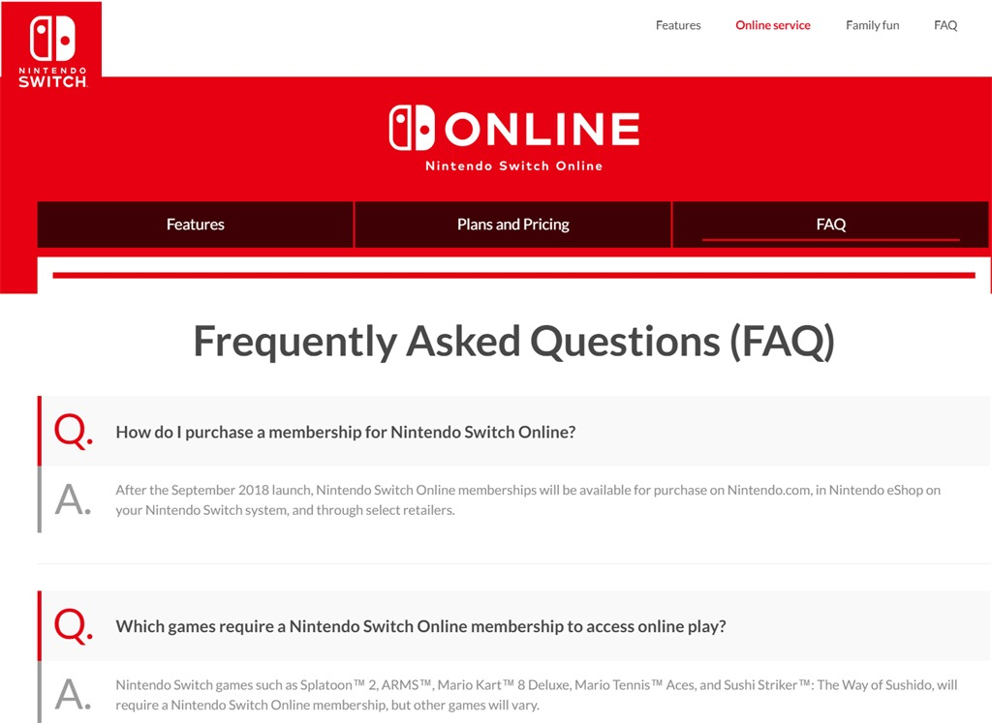
DEMO

Slide 3
What is the purpose of a FAQ page?
The purpose of a FAQ page is to provide quick answers to common questions that your business can anticipate.
An FAQ page empowers customers to self-serve, enabling them to find solutions quickly on their own.
An FAQ page improves user experience.

Slide 4
Study Work
● Existing systems explored:
5 great examples of FAQ pages:
Twitter : https://help.twitter.com/en
YouTube : https://www.youtube.com/creators/top-questions/
McDonald’s : https://www.mcdonalds.com/us/en-us/faq.html
WhatsApp : https://faq.whatsapp.com/
Wikipedia : https://en.wikipedia.org/wiki/Wikipedia:FAQ

Slide 5
How our system is better than existing systems
Our system is better than the existing systems in a number of ways, including :
User-Friendly Design.
Up-to-Date Content.
Ads free interface.
Multi-Language Support.

Slide 6
FAQ Solution
Decide On The Purpose Of The FAQ Page.
Plan In Advance To Maintain And Grow Your FAQ Hub.
Structuring FAQs.
Answers should be to the point.

Slide 7
Technology Stack
Technologies used in my project:
HTML
CSS
JAVA SCRIPT

Slide 8
LIVE DEMO

Slide 9
THANK YOU

